Slide 1


Fuel Efficiency & Emissions in Focus
Data-Driven Insights to Guide Smarter Vehicles and Cleaner Transport
Compiled by: Nelvin Bett

Slide 2

Summary
Purpose: The purpose of this analysis is to evaluate vehicle fuel efficiency and CO₂ emissions using real-world 2014 fuel consumption data. The goal is to provide evidence-based insights that help:
Consumers make smarter car-buying decisions.
Manufacturers design vehicles that meet efficiency and emission standards.
Policymakers craft data-driven environmental and transport policies.
Methodology
We applied the CRISP-DM framework (widely used in data science projects):
Business Understanding – Define objectives: identify drivers of fuel consumption and CO₂ emissions, highlight cost and environmental impacts.
Data Understanding – Analyze 1,067 records from FuelConsumption.csv (Canada, 2014), covering engine size, cylinders, fuel type, vehicle class, transmission, fuel consumption, and CO₂ emissions.
Data Preparation – Cleaned and structured dataset (no missing values).
Exploratory Data Analysis (EDA) – Visualized relationships (engine size, vehicle class, fuel type, transmission, driving conditions) against emissions.
Modeling (Predictive Analysis) – Built regression models to forecast CO₂ emissions from engine size, cylinders, and fuel consumption.
Evaluation & Insights – Extracted key findings, stakeholder implications, and policy recommendations.

Slide 3
Data Source
Dataset: FuelConsumption.csv (2014 Vehicle Fuel Consumption Data, 1067 records)
Source: Government of Canada – Vehicle Fuel Consumption Ratings (2014)
Variables: Engine size, Cylinders, Transmission, Fuel type, Vehicle class, Fuel consumption (city, highway, combined), CO₂ emissions
Notes: Data is complete (no missing values), focused on 2014 model year vehicles.

Slide 4
Why This Analysis Matters
Better Decisions: SUVs may seem practical, but data shows they consume ~50% more fuel than compacts.
Clear Communication: A single metric (CO₂ g/km) keeps everyone aligned and avoids confusion.
Accountability: Automakers can be measured on reducing CO₂ per vehicle — driving responsibility.
Learning & Innovation: Data sparks new questions (e.g., what makes hybrids so efficient?).

Slide 5

Key Findings & Why They Matter
1️⃣ Larger Engines & More Cylinders → Higher CO₂
• Finding: Engines >3.0L or >6 cylinders emit far more CO₂.
• Why it Matters: Higher fuel costs & emissions. Policymakers can target efficiency standards.
2️⃣ SUVs & Pickups Consume the Most Fuel
• Finding: SUVs use ~50% more fuel than compacts.
• Why it Matters: Higher costs for consumers, regulatory risk for manufacturers.
3️⃣ Diesel & Gasoline Emit the Most CO₂
• Finding: Diesel highest emitter, hybrids/electrics lowest.
• Why it Matters: Incentivizing EVs/Hybrids reduces emissions & energy dependence.
4️⃣ City Driving Consumes ~30% More Fuel
• Finding: Stop-and-go driving is fuel intensive.
• Why it Matters: Strengthens case for urban EV adoption & traffic reforms.
5️⃣ Manual Cars Slightly More Efficient
• Finding: Manual cars average lower fuel use than automatics.
• Why it Matters: Highlights technology trade-offs; automakers can innovate smarter transmissions.

Slide 6
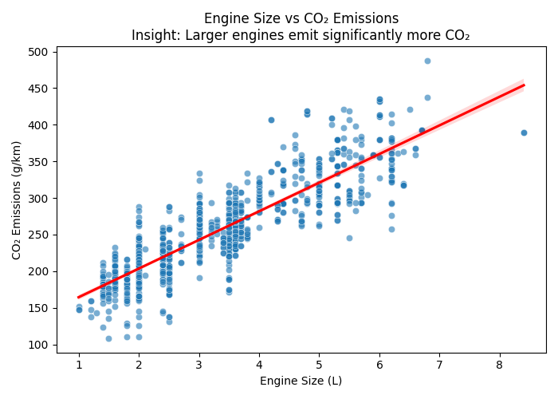
Engine Size vs CO₂ Emissions
Key Insight: Larger engines (>3.0L) emit significantly more CO₂ — higher costs & environmental impact.
Source: FuelConsumption.csv – Government of Canada, 2014

Slide 7
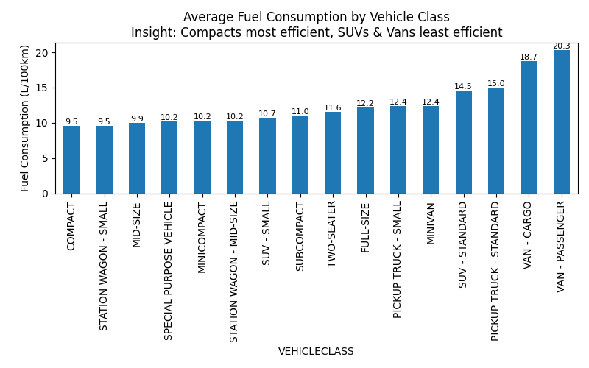
Average Fuel Consumption by Vehicle Class
Key Insight: SUVs & vans consume ~50% more fuel than compacts — least efficient classes.
Source: FuelConsumption.csv – Government of Canada, 2014

Slide 8
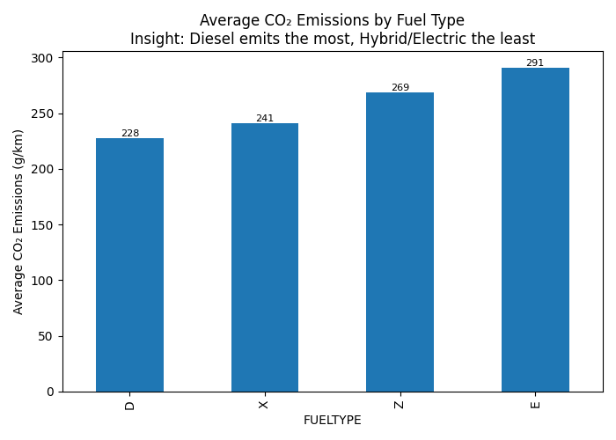
Average CO₂ Emissions by Fuel Type
Key Insight: Diesel has the highest CO₂ emissions; hybrids/electric the lowest.
Source: FuelConsumption.csv – Government of Canada, 2014

Slide 9
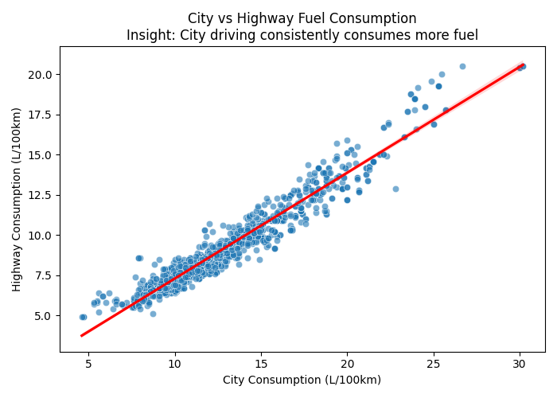
City vs Highway Fuel Consumption
Key Insight: City driving consumes ~30% more fuel than highway driving.
Source: FuelConsumption.csv – Government of Canada, 2014

Slide 10
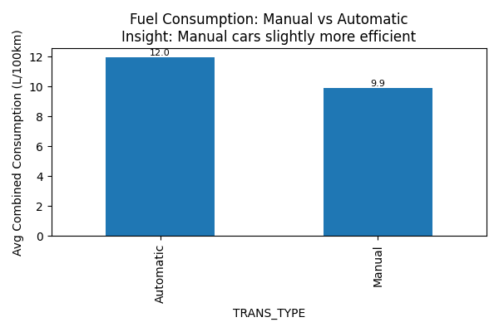
Manual vs Automatic Transmission
Key Insight: Manual cars are slightly more fuel-efficient than automatics.
Source: FuelConsumption.csv – Government of Canada, 2014

Slide 11
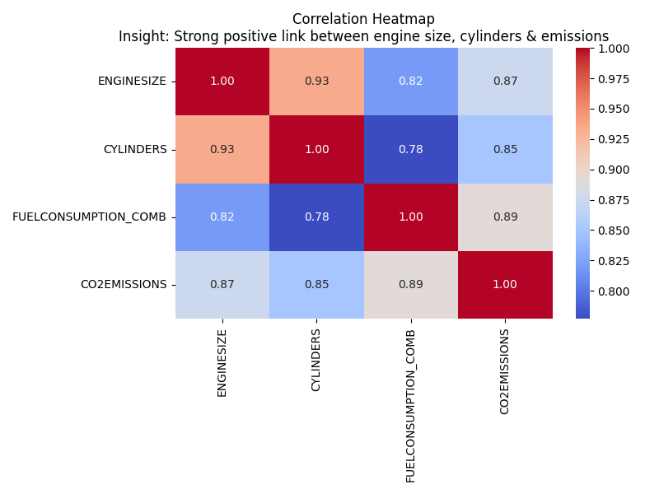
Correlation Heatmap
Key Insight: Engine size, cylinders, and combined fuel use strongly drive CO₂ emissions.
Source: FuelConsumption.csv – Government of Canada, 2014

Slide 12
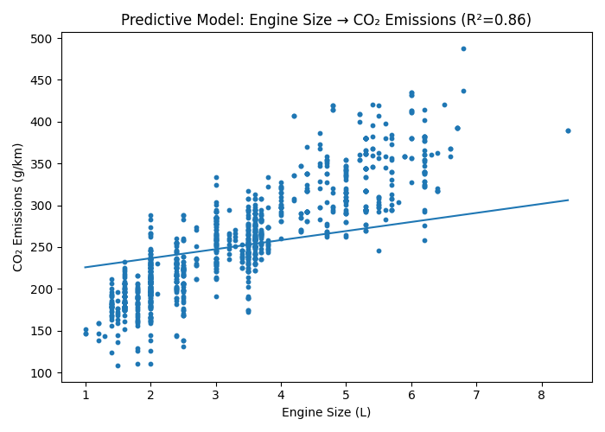
Predictive Model Example: Regression
Engine Size (L) | Cylinders | Fuel Cons. (L/100km) | Predicted CO₂ (g/km)
2.0 | 4 | 8.5 | 199
3.5 | 6 | 11.0 | 254
5.0 | 8 | 15.0 | 324
Key Insight: CO₂ can be predicted from engine size, cylinders, and fuel use (R² score).
Key Forecast Insights:
Downsizing from 5.0L → 2.0L cuts ~125 g/km CO₂ per vehicle.
SUVs/Trucks (5.0L+) are most emission-heavy, major policy target.
Compacts (2.0L) are most efficient, with significantly lower costs & emissions
Source: FuelConsumption.csv – Government of Canada, 2014

Slide 13
Strategic Recommendations
For Buyers:
– Prioritize hybrid/electric vehicles for cost & environment.
For Manufacturers:
– Build efficient smaller engines, promote affordable EVs
For Policymakers:
– Incentivize EV/Hybrids, expand charging infrastructure

Slide 14
Analytics Roadmap (Timeline Infographic)
DESCRIPTIVE
What happened?
• EDA, Charts, KPIs
PREDICTIVE
What will happen?
• Regression, Classification
• Forecasts, Scenarios
PRESCRIPTIVE
What should we do?
• Optimization
• Policy Simulation
• Consumer Tools

Slide 15
Limitations & Learning Culture
Dataset covers only 2014 vehicles – not reflective of current EV/hybrid adoption.
Regional scope (Canada) – may not generalize globally.
Missing variables (vehicle weight, drivetrain, hybrid markers).
Exploratory approach – correlations shown, but causality not confirmed.
Being transparent about limitations builds trust and sparks new questions.

Slide 16
Next Steps & Data Product Roadmap
Current: One-time analysis & slide deck.
Next: Build an interactive dashboard (Power BI / Tableau).
Future: API or automated pipeline for real-time tracking.
Short term: Share insights with stakeholders.
Medium term: Dashboard with filters (class, fuel type, engine size).
Long term: Predictive modeling integrated into policy simulations & consumer tools.

Slide 17
Ownership & Accountability
Consumers: Shift to hybrids/electrics → reduce costs and emissions.
Manufacturers: Design smaller, efficient engines and scale affordable EVs.
Policymakers: Incentivize EV adoption and expand charging infrastructure.
Clear accountability ensures insights turn into measurable change.

